Slide 1

Project - Movement
Computer Graphics
MIEIC
Basic animation
Teresa Matos
23-24 March 2020

Slide 2
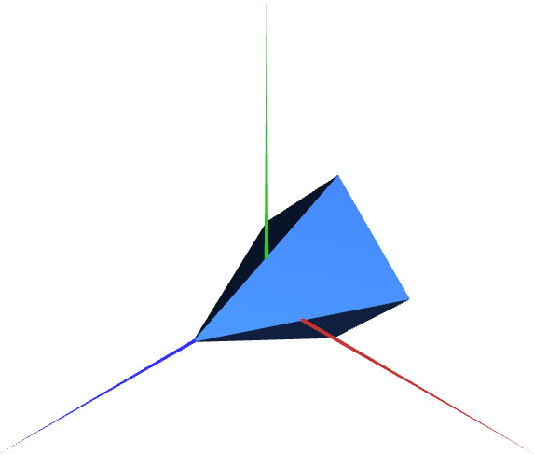
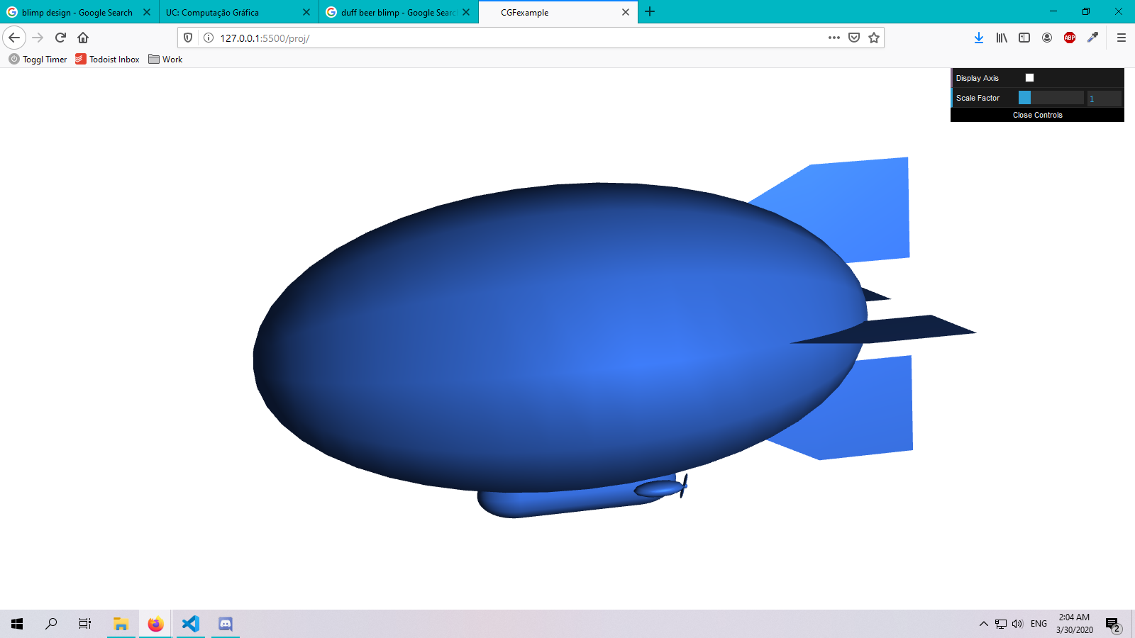
MyVehicle
Object in scene controllable by user through key presses
Default state of vehicle is:
Stationary (no speed)
Centered in origin (0,0,0)
Front towards positive Z axis

Slide 3
Steps for vehicle animation
The worksheet for the project delineates different steps to apply animation
The steps in the vehicle’s class can be broken down into three phases:
Define default state
Update current state
Apply state in vehicle’s display

Slide 4
1 Define Default State - Variables
In the constructor, we add the variables that describe the default state.
Default state of vehicle is:
Stationary (no speed)
Centered in origin (0,0,0)
Front towards positive Z axis
constructor(...){
…
this.speed = 0;
this.position = [0,0,0];
this.orientation = 0;
}

Slide 5
2 Update Current State
The 3 variables that define the vehicle’s state are updated/changed differently
The speed and orientation are updated only with user input (key presses)
The position of the vehicle periodically (according to scene’s update period)

Slide 6
2 Update Current State - Orientation
The vehicle’s orientation is related to its rotation around the Y axis
The orientation changes when the ‘A’ or ‘D’ keys are pressed
‘D’ key
‘A’ key

Slide 7
2 Update Current State - Speed
The vehicle’s speed changes when the ‘W’ or ‘S’ keys are pressed
‘W’ increases speed every time it’s clicked, ‘S’ decreases it until zero It should move when speed is positive, not only when ‘W’/‘S’ keys are pressed
‘D’ key
‘A’ key

Slide 8
2 Update Current State - Position
The vehicle only moves in X and Z axis (Y is always 0)
At any given moment, we want to move the vehicle:
from its current position
In the direction it is facing (according to orientation)
update(){
position = position + directionVector
}
direction vector

Slide 9
2 Update Current State - Position
We calculate the directional vector using the current orientation
directionVector.x = sin(orientation)
directionVector.y = 0
directionVector.z = cos(orientation)
x
z
Directional vector, considering initial orientation = +Z direction

Slide 10
2 Update Current State - Position and Speed
The speed of the vehicle influences the amount of movement (distance)
Multiplying a vector by a scalar changes the magnitude of that vector
update(){
position = position + directionVector * speed
}
Directional vector (unitary magnitude)
Scaled directional vector (scalar > 1)

Slide 11
3 Apply state in display
In the vehicle’s display() function, we apply the geometric transformations to animate the 3D object(s)
display(){
translate(position);
objects.display();
}
Is it enough to apply translation?

Slide 12
3 Apply state in display
In the vehicle’s display() function, we apply the geometric transformations to animate the 3D object(s)
display(){
translate(position);
rotate(orientation);
objects.display();
}
We need to rotate the vehicle before positioning it.

